Slide 1


Animal Crossing Cam
Team 7
Amy, Lucca, Henry, Ethann, Lachlan
Notes:
Good Afternoon everyone,
Here is our presentation on the Animal Crossing Cam
I wanted to take a moment to address the fact that our entire team has come up to present as we all put in so much effort and it would feel incomplete if our entire team was not presenting.

Slide 2
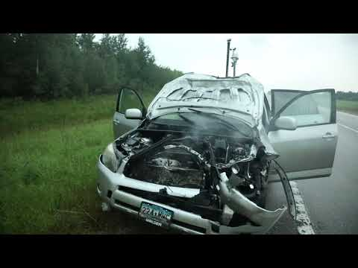

Notes:
Imagine driving on the road and this happens….
(play video)
(stop)
On August 13th, 2020, a man was driving his car on the highway in Minnesota and a deer ran onto the road and was unfortunately killed. In this state and this state alone, about 12,000 deer are killed EACH YEAR.
Accidents likes these occur more than you think. Not only do they injure or kill the animal, but cause damage to vehicles as well.

Slide 3
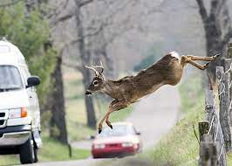

One Million+ accidents
$1 Billion in auto damage
Notes:
Over one million deer accidents have been reported in only one year. Even worse, deers aren’t the only party injured because of an accident. There are over ten thousand reported injuries in the U.S. from deer accidents causing over $1 billion in damage.

Slide 4
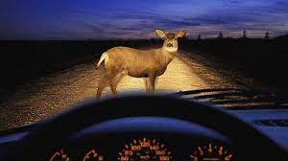
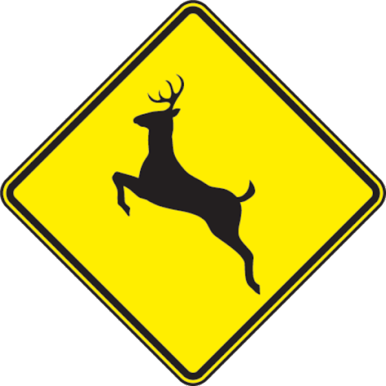
WHAT IS THE PROBLEM?
Public Safety
Conservation of crossing animals
Inability to stop in time
Variation of reaction times
Urgency of our Solution
Current technology only lists potential presence of animals
Our solution needs to be put in place in order to prevent these accidents that result in catastrophic damages and injuries
Alternative uses of our technology
Notes:
WHAT IS THE PROBLEM
The probelm is evident through the previous figures: when drivers are moving at high speeds, they cannot stop to avoid deer crossing the road.
Our creative solution not only increasing public safety for traveling humans, but contributes to conservation of crossing animals, some of which could be endangered species if in specific areas. (many animals)
Many dangers that come with slow reaction times and intoxication are addressed in our tech. One study pointed to an average decreased reaction time of 120 milliseconds associated with a blood alcohol concentration level of 0.08, the legal limit in the United States.
When cruising at 70 miles per hour, this intoxication level would translate to stopping 12 feet later than intended.. at this point it is too late
Urgency of our solution
Unlike current technology and road signals that simply state a potential presence of an obstacle, our creative smart tech solution is a live status of the road that will interact the incoming drivers.
Put simply, our solutions needs to be put in place in order to prevent these accidents that result in damages and injuries.

Slide 5
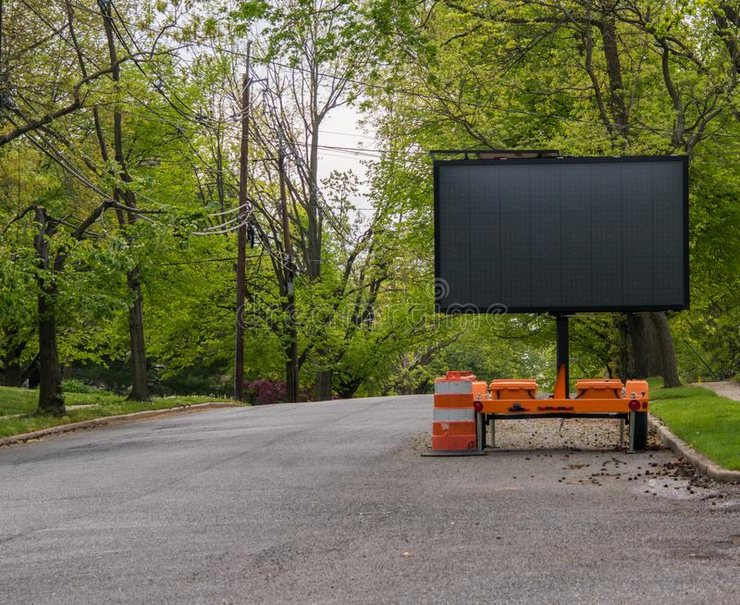
What is our solution?
Obstacle Crossing Camera #2
🦌
Obstacle Crossing Camera #1
🦌
Deer
100 ft
Interactive Sign
🚧
Notes:
Our solution is to set up cameras that can detect if an animal, like a deer is crossing the road. This camera will be located at the blue markers.
When the camera detects an animal, a signal will be sent to the green marker (a interactive slide) that will alert drivers to slow down.
This sign will project the following pieces of information:
The distance to the obstacle
The Type of obstacle: bikers will care if it is a bear vs. a deer
Talk about where we got data from (kaggle)

Slide 6
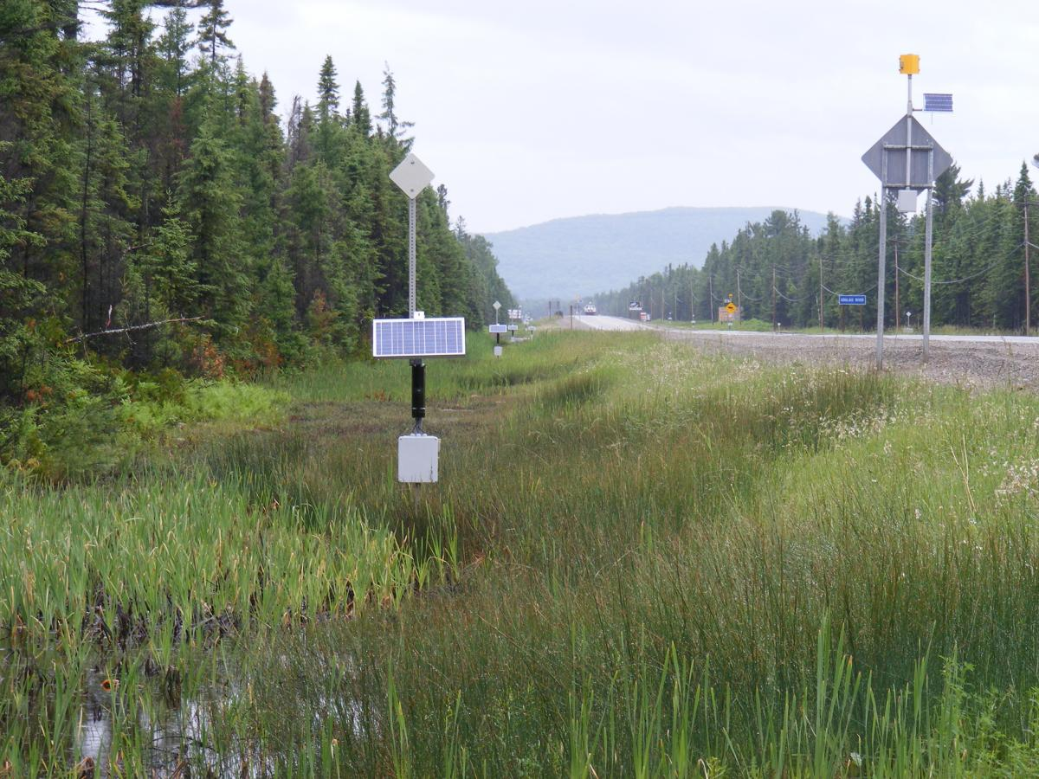
Cost and Impact
The cost of the materials to build our solution comes to $3,000
Power supply (solar panels and batteries)
Raspberry pi
Camera
Case
Braincraft HAT
Outdoor electric sign
(This doesn’t include the manpower required to build/maintain our solution)
Each additional camera: $25
Notes:
The cost of the materials to build our solution comes to $3,000. This includes the price of a power supply, a raspberry pi, a camera, a case, a Braincraft HAT and an outdoor electric sign. Each additional camera costs 25 dollars. (This price doesn’t include the man power required to build/maintain our solution).
But with success, our solution will enable humans and animals alike to remain safe when traveling to destinations. Furthermore, it will prevent injuries, deaths, and $1 billion worth of vehicle damage annually.

Slide 7

THANK YOU

